Slide 1

HOTEL REVIEWS

Slide 2

TABLE OF CONTENTS
01
02
03
04
BUSINESS UNDERSTANDING
DATA UNDERSTANDING
DATA PREPARATION
MODELING

Slide 3

01.
BUSINESS OVERVIEW

Slide 4

BUSINESS PROBLEM
How can hotels increase number of customers?
Increase number of return customers
Attract more new customers

Slide 5
TASKS
Fully assess the current situation
understanding the analytics capability
Predictive analytics could help increasing number of customers
Which type of customer were most likely to NOT return?
What changes/ offers would a particular customer best respond to?
What factors were likely to affect the hotel booking rate?
Basic structure
common features

Slide 6
Reasons
Predicting problem
Analytics Solution
What factors were likely to affect the hotel booking rate?
Data availability and reasonably easily accessible
Prediction model could be easily integrated.
Explained main drivers behind gaining customers

Slide 7

02.
DATA
UNDERSTANDING

Slide 8
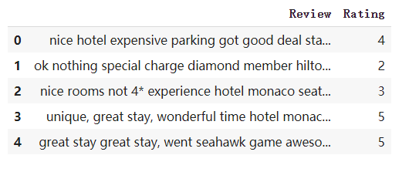
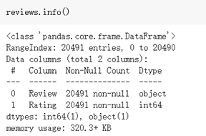
20,491
Data Source:
tripadvisor_hotel_reviews.csv
https://www.kaggle.com/andrewmvd/trip-advisor-hotel-reviews
number of instances included in dataset

Slide 9


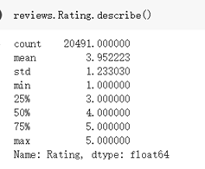
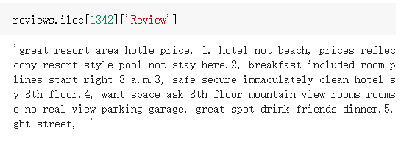
20,491
1. RATING
number of instances included in dataset
levels: 1, 2, 3, 4, 5
2. REVIEW
2 Features:
Review ( number )
Rating (string)

Slide 10

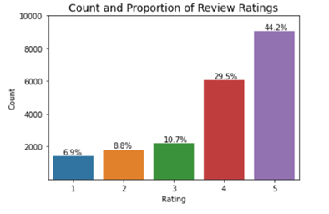
Rating:
Exponential Distribution
1st mode: 5 star (44.2%)
2nd mode: 4 star (29.5%)

Slide 11
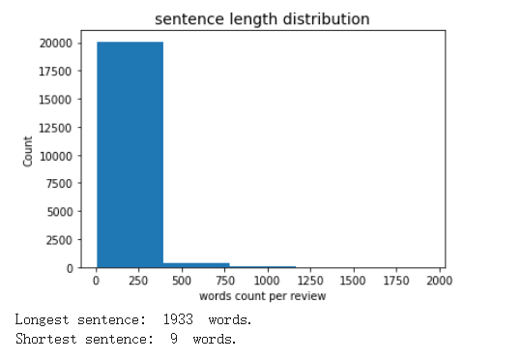
Review:
Exponential Distribution
Longest sentence: 1933 words.
Shortest sentence: 9 words.

Slide 12
“ great resort area hotle price, 1. hotel not beach, prices reflect, want beach large balcony resort style pool not stay here.2, breakfast included room price excellent, early, lines start right 8 a.m.3, safe secure immaculately clean hotel small rooms, coin laundry 8th floor.4, want space ask 8th floor mountain view rooms rooms hotel lanai, lanai huge no real view parking garage, great spot drink friends dinner.5, public access beach right street, ”

Slide 13

03.
DATA PREPROCESSING

Slide 14

OUR SERVICES
Missing Value
Remove Duplication
Sampling
Over Sampling

Slide 15
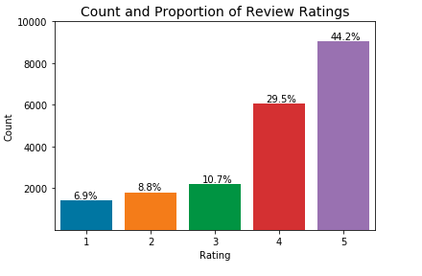
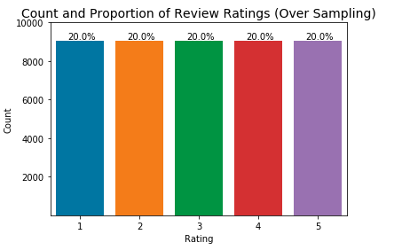

Slide 16
OUR PLANS
Normalization
(1) stemming, (2) lemmatization, and (3) lowercase
Tokenization
Split strings of text into smaller pieces
Stopwords
Remove stopwords
Notes:
get the root of words, change the characters to lowercase
sentence to words
stopwords: the, of, and,

Slide 17
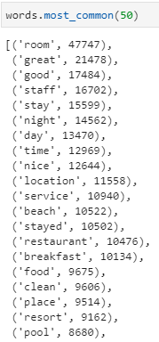
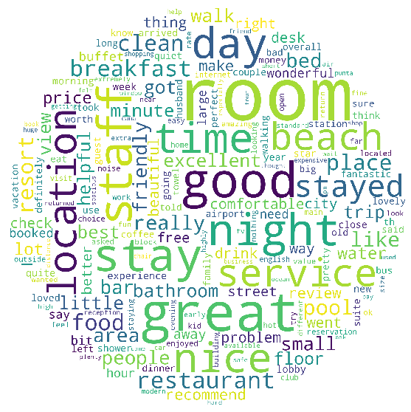
Word Count
&
Word Cloud

Slide 18

04.
Modeling
Notes:
PH start

Slide 19

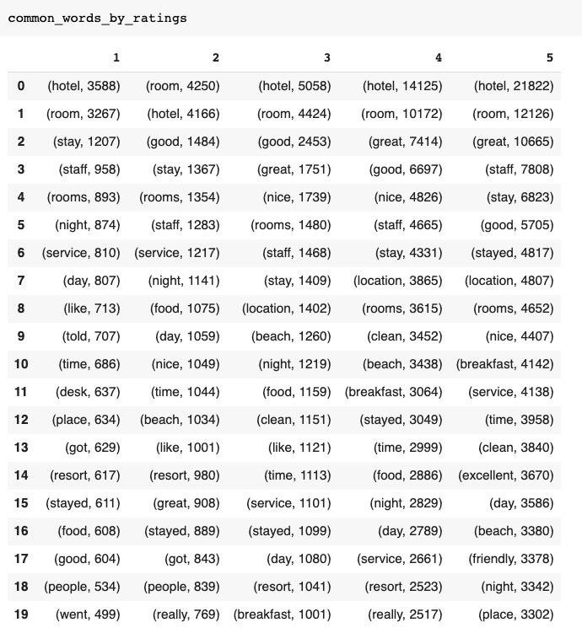
TRY 1: Find common words
NLTK (the Natural Language Toolkit): a suite of libraries and programs for symbolic and statistical natural language processing (NLP).
Feedback: 1. Remove stopwords easily.
2. Fast.
---
3. Not accurate.
4. Doesn't remove some common words like "hotel", results look very similar.

Slide 20
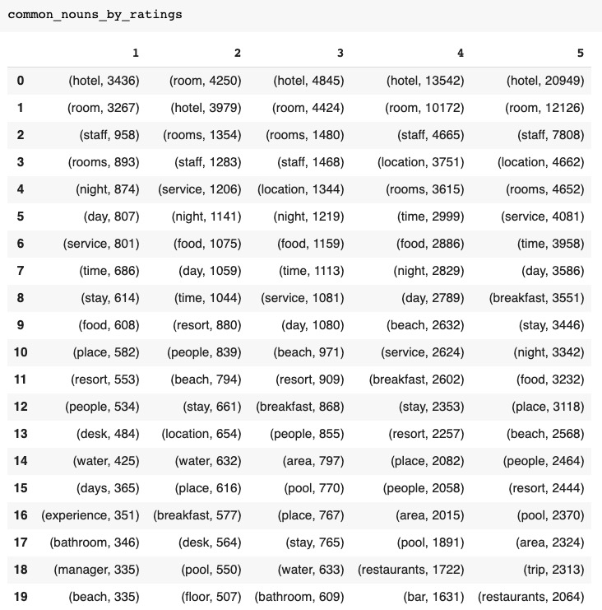
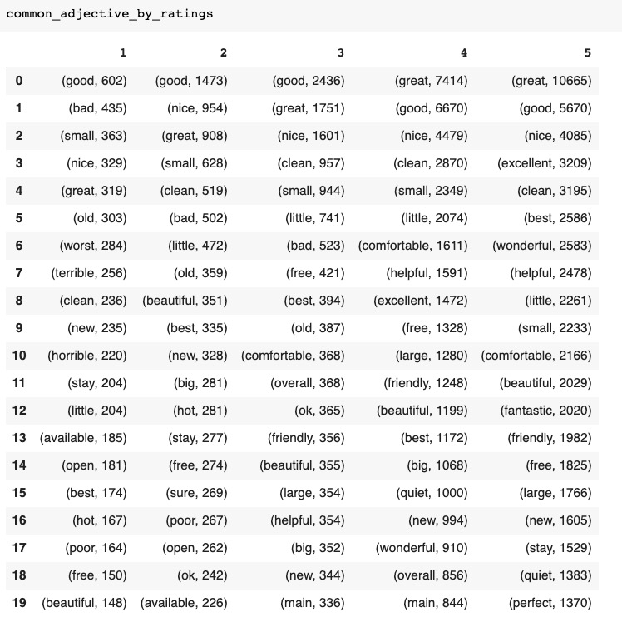
TRY 2: Improve common words

Slide 21
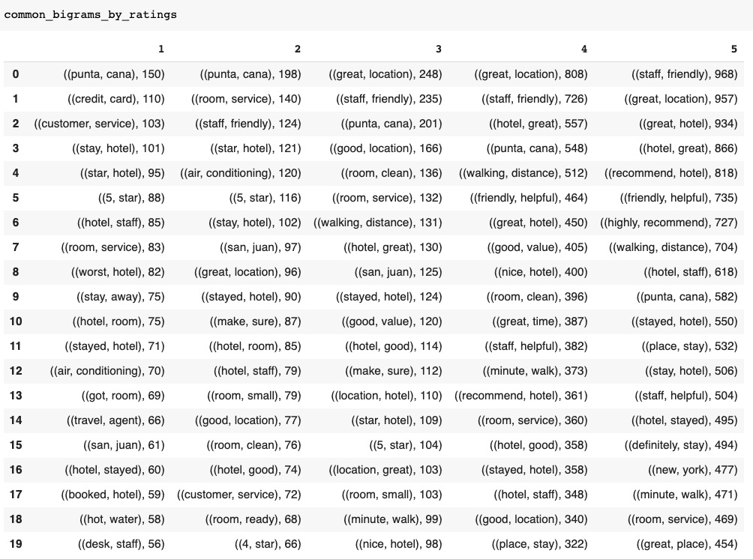
TRY 2: Improve common words
Feedback:
1. Seems improved, get something useful.
---
2. Can't produce n-grams in the same time, e.g. 'great location' and 'good room service' can't be displayed at the same time.
3. Some useless words like 'san juan' and 'punta cana' are included, should try to remove them.

Slide 22
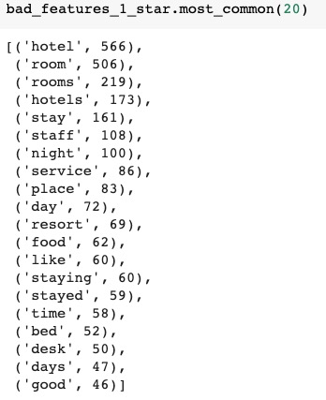
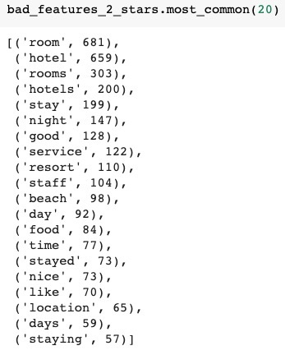
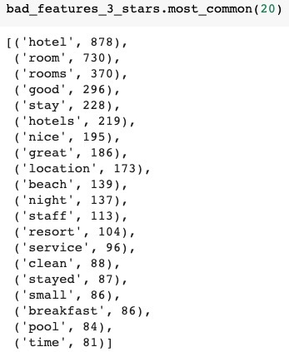
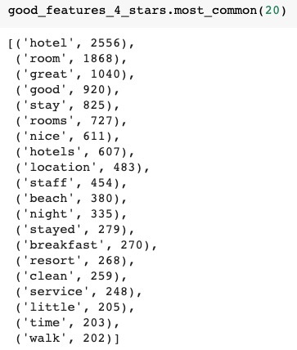
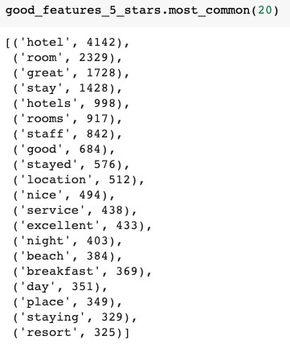
TRY 3: Get keywords
Gensim: an open-source library for unsupervised topic modeling and natural language processing.

Slide 23
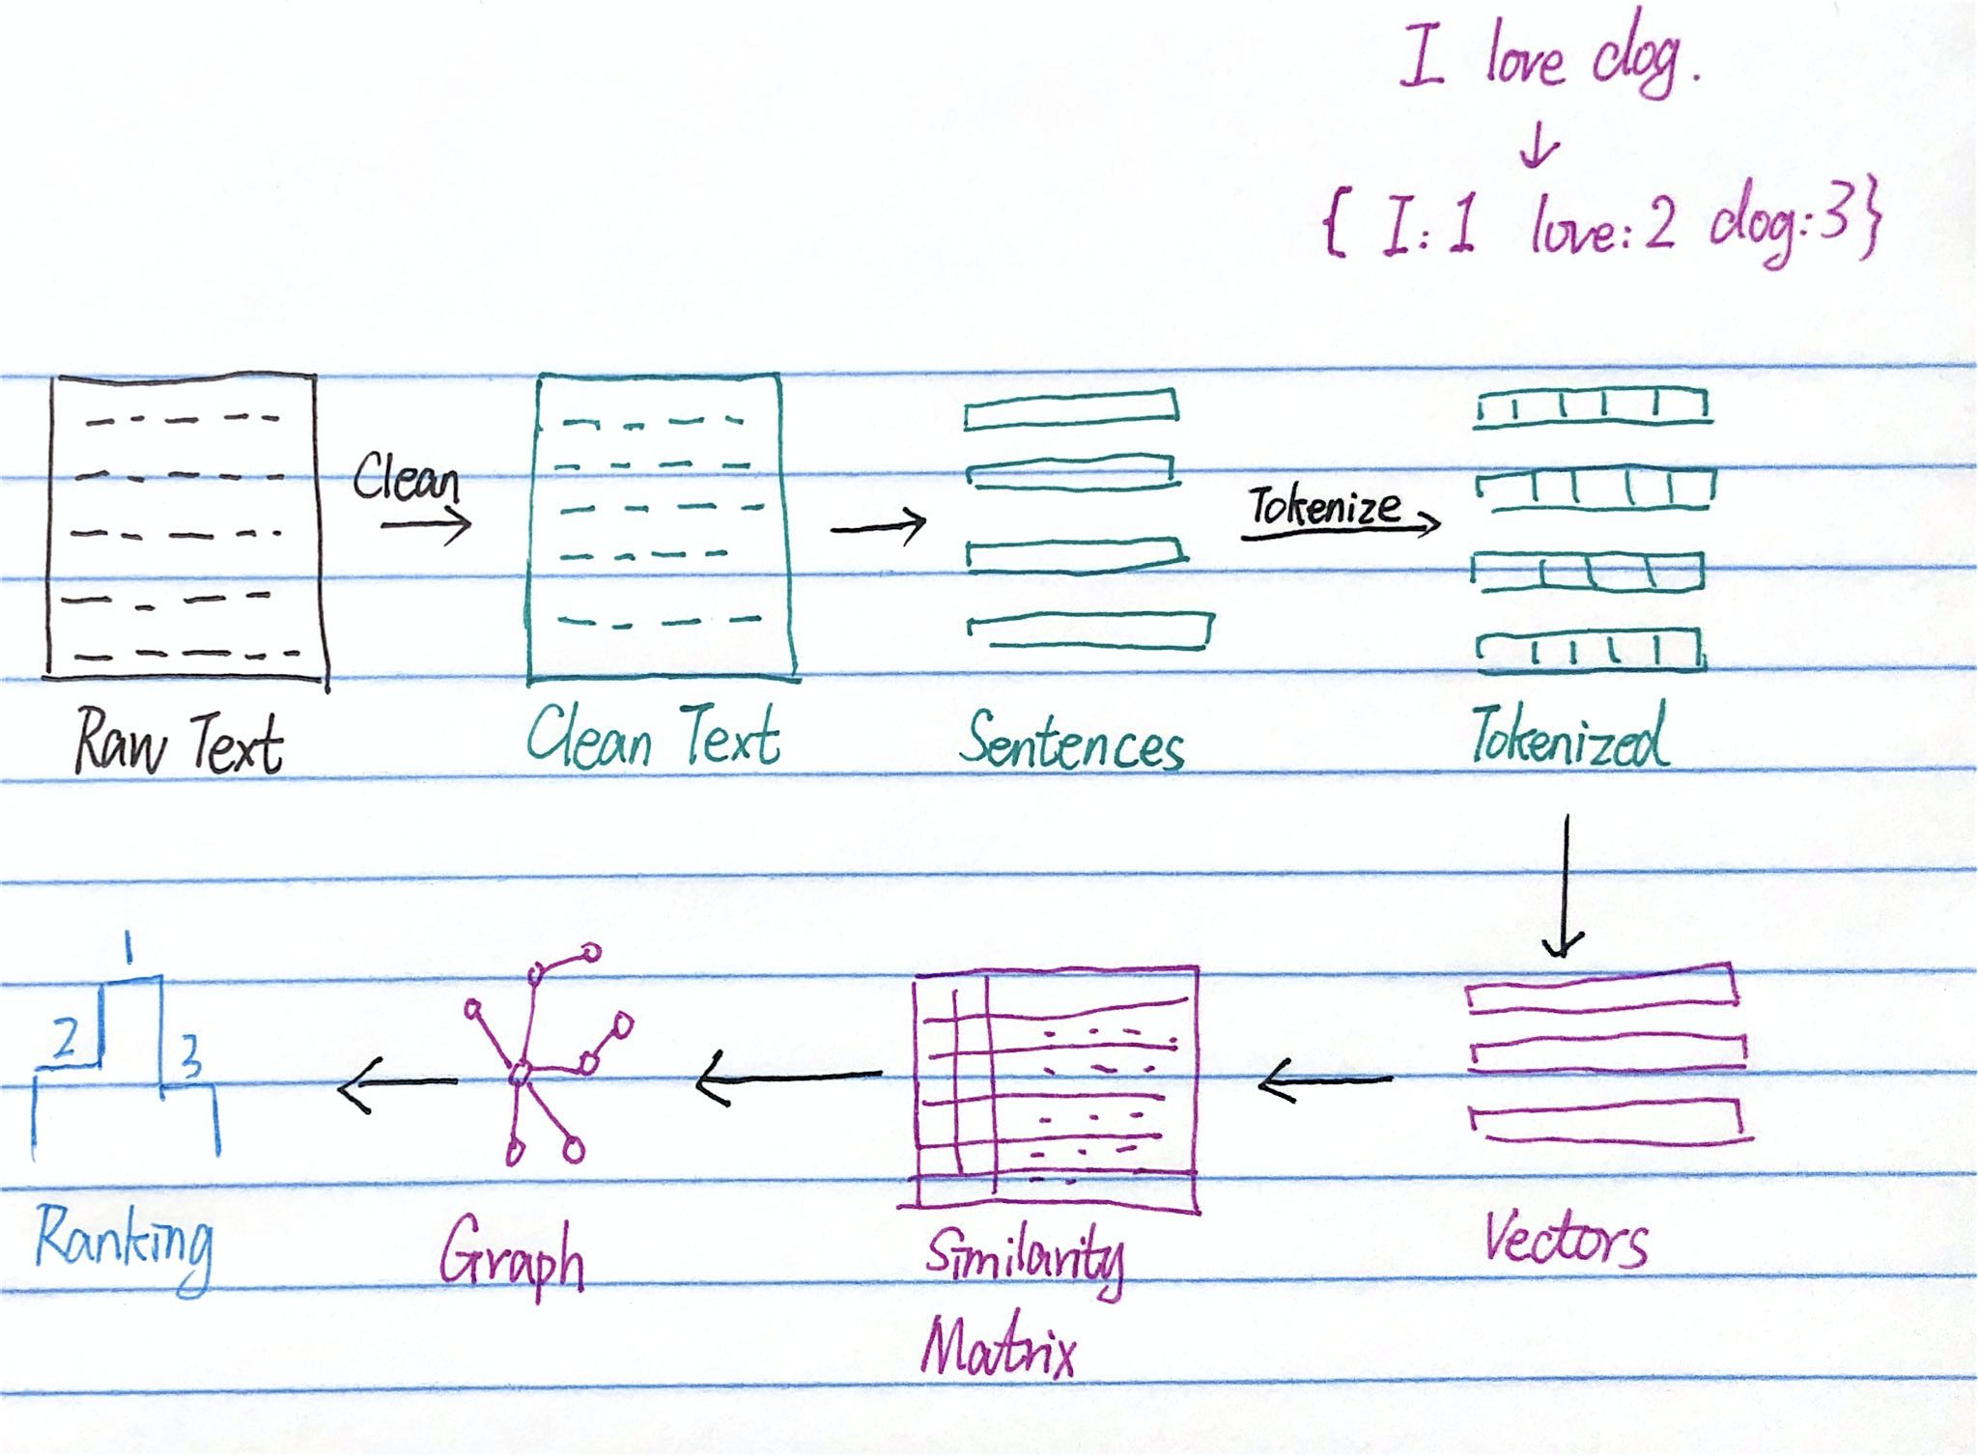
TRY 3: Get keywords
Gensim: an open-source library for unsupervised topic modeling and natural language processing.

Slide 24
TRY 3: Get keywords
Gensim: an open-source library for unsupervised topic modeling and natural language processing.
Feedback:
1. Remove stopwords.
2. Smarter.
3. Lemmatization
---
4. Still not accurate.
5. Slower.

Slide 25
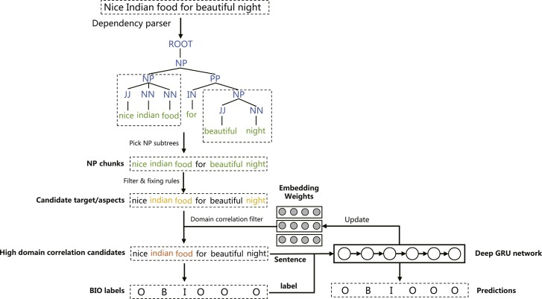
Future work
Aspect term and opinion target extraction.
–– A hybrid unsupervised method for aspect term and opinion target extraction
Notes:
PH end

Slide 26
Instructions for use
In order to use this template, you must credit Slidesgo by keeping the Credits slide.
You are allowed to:
- Modify this template.
- Use it for both personal and commercial projects.
You are not allowed to:
- Sublicense, sell or rent any of Slidesgo Content (or a modified version of Slidesgo Content).
- Distribute Slidesgo Content unless it has been expressly authorized by Slidesgo.
- Include Slidesgo Content in an online or offline database or file.
- Offer Slidesgo templates (or modified versions of Slidesgo templates) for download.
- Acquire the copyright of Slidesgo Content.
For more information about editing slides, please read our FAQs:
https://slidesgo.com/faqs

